Slide 1

Dig Deeper with
Engagement Games
A presentation deck for training educators on the Project MASH engagement games process, from the Engagement Lab.
Full day version
Notes:
Project MASH is an initiative of the Pearson Foundation and the New Learning Institute. MASH has funded a range of community partners, including the Engagement Lab, to share their unique approaches to learning with a broader audience of teachers and students.

Slide 2
Today
Welcome (15 min)
Play & Games (85 min)
Engagement Games (1hr 50 min)
Project MASH (15 min)
Reflection (30 min)
Conclusion (10 min)
Notes:
This does not include lunch or breaks during the day, for which we’ve budgeted an hour. We suggest taking lunch after the @Stake activity. If your group has extra time, you can extend the design and playtesting of engagement games, “Challenge #4.”
Set-up notes:
SET-UP and LOGISTICS
1. Groupings: Participants should work in small teams. Teams might self-select OR may be pre-assigned to save time.
2. Space set-up: A space where teachers can easily work in groups works best. It’s also great to have access to a white board or chalk board.
3. Materials: This power point; overhead projector, wall space or board for opening brainstorming/discussion, markers, pencils/pens, paper for groups to write on, and game pieces (dice and small moveable objects).
4. TIMING: This is a 6 hour PD. BREAKDOWN:
Introduction: slides 1-3 (15 min)
Play & Games: slides 4-15 (60 min)
Games and Civic Learning: slides 16-32 (120 min)
Engagement Games: slides 33-45 (105 min)
Academic Connections, Resources 46-47 (45 min)
5. Do Ahead: Read @Stake on Project MASH, print out cards. If at all possible, choose a group of four teachers to practice playing @Stake, so they can demo 1 round of the game for the larger audience at the PD. This speeds ups the learning process and gets the larger group excited.

Slide 3
Challenge #1: Identify Challenges
Goal:
Identify challenges in your school community
Time:
10 min
Work in small groups to create a list of some broad challenges facing your school community.
Write these challenges down, give each a name/heading.
If the workshop has more than four groups, then each group should decide which 1 or 2 of their challenges they find to be the best material for discussion. (We’ll revisit these challenges later in the workshop.)
See the next slide for sample challenges…
Notes:
These challenges could be written down on post-its, on the board, etc.
Make sure they remain accessible for the @Stake and Engagement Game activity later in the workshop.

Slide 4
Create broad challenges that concern a range of different school community members. For example:
Going Green: How can we make our school more environmentally sustainable?
Eat Smart: How can we provide students with access to healthy food choices inside and outside of school?”
Youth Jobs: How can we create opportunities for students to work at jobs, earn a decent wage, and learn skills valuable for the future?”
Respect: How can we create a shared language and culture of respect at the classroom, school, and larger community level?

Slide 5
What is play?

Slide 6
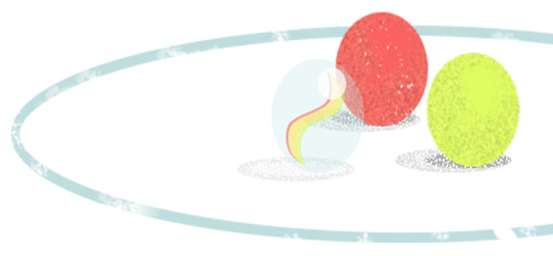
What is Play?
An activity in which means are more valued than ends
Is non-literal, imaginative, marked off in some way from reality (a.k.a. the magic circle)
Notes:
When the process is meaningful in and of itself, enjoyable in and of itself, valuable in and of itself.
An important feature of play is that while being marked off from reality, it can also augment reality: It can help us generate new ideas and perspectives. It can leave us feeling refreshed. But it creates a safe space for failure

Slide 7
Children often encounter the world through play
Notes:
So how do we recognize play?

Slide 8
Games structure the “magic circle” of play with goals and guidelines for action.
Notes:
Play is a great resource to harness for learning, and games help structure the play around certain goals, rules of behavior, and room for student choice.

Slide 9
Games help us harness the power of play to:
Foster learning and empathy (which are necessary to develop strategy)
Build social norms (i.e., competition and cooperation)
Allow for a variety of player motivations
Notes:
Some players are initially motivated by the external rewards; others, by the strategy, or the collaboration, or the moment-to-moment intensity of game play.
And ultimately, a good game uses extrinsic motivations (rewards) not to compel certain behaviors, but to compel intrinsic motivations to align with the activity. A good game simply motivates players to take ownership of the activity and their role in it.

Slide 10
Uncertainty and suspense
are built into the game’s structure.
Escalating challenges and clear feedback
focus attention,
support reflection,
and build meaning.
Notes:
You literally can’t progress in any game unless you’ve experimented with a way of playing, reflected on mistakes, and attempted to apply what you’ve learned in order to get better, and get past the next challenge. In short, you can’t play a game without learning.
Later we will go into how to align the learning that take place in game with learning about the real world. But for now, to think on a less philosophical and more practical way about good game design…[see next slide]

Slide 11
Elements of a game
Objective and feedback: What does it mean to win? How to players evaluate their progress?
Actions/mechanics: What actions can players take, and how does this move the game forward? What are the obstacles?
Clear rules/boundaries: What are the limits on player choice? What is/is not allowed?
...and room to play: uncertainty, choice, strategy, interaction
Notes:
Failing safely: Making a mistake on schoolwork can feel like big a deal, but in most games we can imagine, lots of little failures are expected in order to develop any skill.
Room to play: If players could win simply by following a prescribed set of steps, there wouldn’t be a game. Games create uncertain conditions in which we get to make choices, choose strategies, and experience suspense and other heightened emotions. The playful drama of a good game can be fun and energizing for everyone.

Slide 12
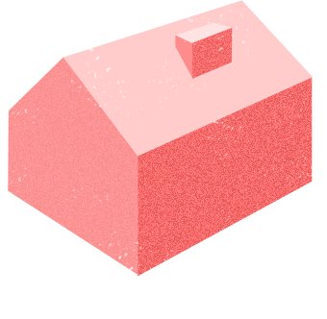

Modification of existing game elements is a common strategy for creating new games.
Most of us know the game of Checkers.
In fact, Checkers is a mod of an English game called Draughts, played with bottle tops… And Draughts is itself a mod of several similar ancient games dating back several thousand years…
Notes:
This is a warm-up activity that should take approximately 15 minutes. Those who arrive early may have extra time to complete this and discuss.
This activity will help teachers get into a flexible mindset to think about and describe the game design process. This initial brainstorm is echoed through the workshop session, as participants modify or design several different games.
If teachers like this activity, they can find more at alpha.projectmash.org, under the activites, “Check Yourself,” and “The Red and the Black.”

Slide 13
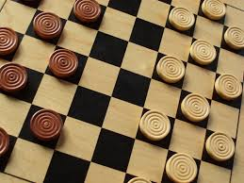
Elements of Checkers
Objective and feedback: Winning is achieved by clearing your opponent from the board, while losing your own pieces gives feedback on your gameplay.
Actions/mechanics: Pieces advance diagonally and capture with a diagonal jump.
Rules/boundaries: Players can only move on their own color, on the board, cannot jump their own pieces, and must land on an open space.
Room to play: A player doesn’t know what their opponent will do, but may have many options available to them.
Notes:
Failing safely: Making a mistake on schoolwork can feel like big a deal, but in most games we can imagine, lots of little failures are expected in order to develop any skill.
Room to play: If players could win simply by following a prescribed set of steps, there wouldn’t be a game. Games create uncertain conditions in which we get to make choices, choose strategies, and experience suspense and other heightened emotions. The playful drama of a good game can be fun and energizing for everyone.

Slide 14
Challenge #2: Mod It!
Goal:
To modify Checkers, the modern version of Draughts
Time:
20 min
Steps:
Work in groups of 4-5.
Discuss what you know about how to play checkers.
How can you modify it? See the next slide for more specifics
Name your game, and create your pitch.

Slide 15
Challenge #2: Mod It!
Goal:
To modify Checkers, the modern version of Draughts
Time:
20 min
Pick 2 or more of the following game elements to mod:
Objective and feedback: In “Suicide” Checkers, the first player who can’t make a legal move wins..
Actions/mechanics: What if you could bargain to get checkers back? Or sacrifice pieces to take another turn? What if play happened off the board and involved physical movements in the room?
Clear rules/boundaries: In some versions of Draughts, players have to capture as many pieces as they can in each turn.
Theme: Introduce new colors and shapes or use humanoid figurines instead of discs?

Slide 16
Challenge #2: Mod It!
Goal:
Pitch your game
Time:
15 min
Each group pitches their game to the other groups:
Name
Objective and feedback
Actions/mechanics
Rules

Slide 17
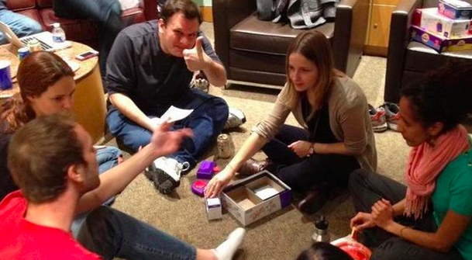
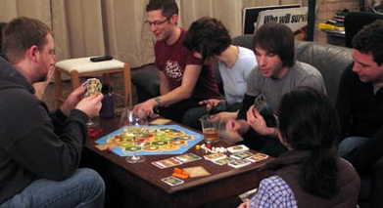
Challenge #2: Mod It!
Goal:
Play another group’s game
Time:
15 min
Each group plays the game created by another group. (If there is an even number of groups, pair up. Otherwise, rotate.)

Slide 18
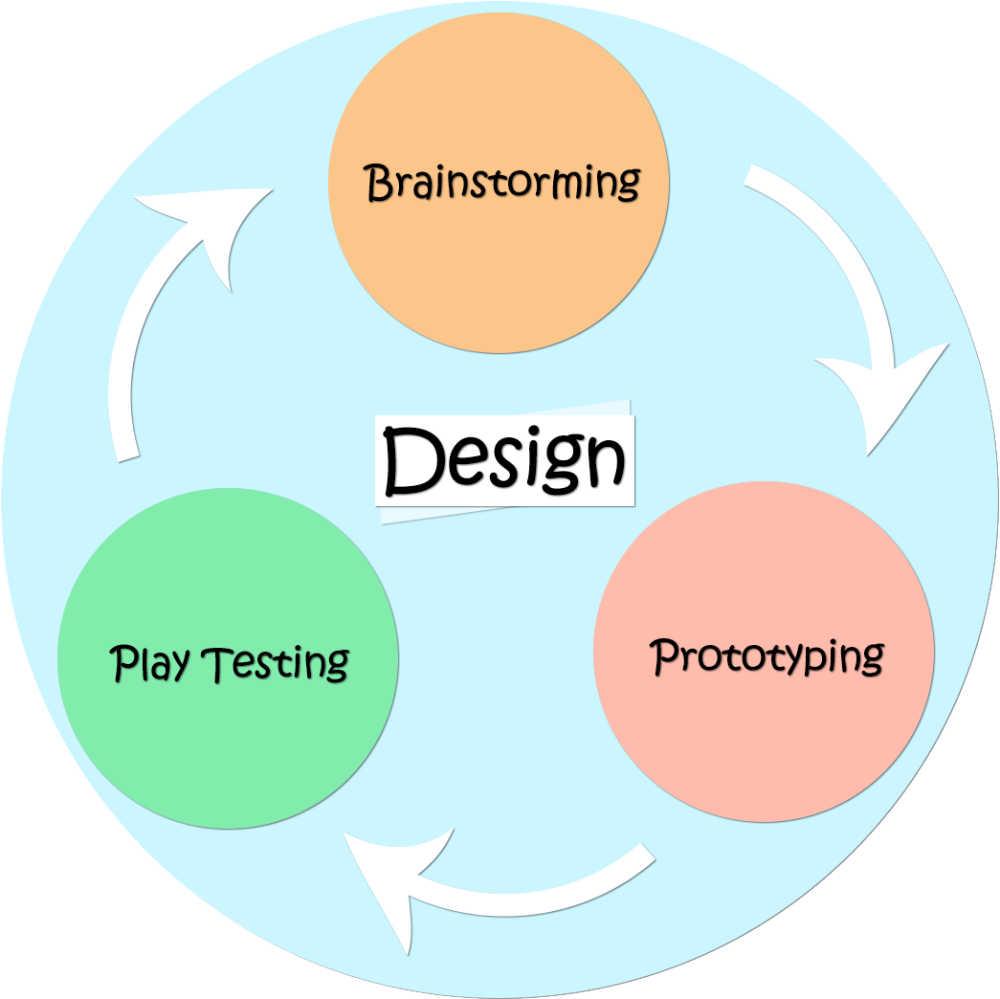
Challenge #2: Mod It!
Game design is a cyclical process.
You can always improve or modify what you have for new circumstances.
Most games go through many cycles, or iterations, before they’re published.
Notes:
We only had time for one iteration today, but your students will benefit from many iterations.

Slide 19
Challenge #2: Mod It!
Goal:
Share, Reflect, Discuss
Time:
10 min
Consider your group’s design and the other group’s design:
What elements of each worked for you?
What would you like to change?
Notes:
Whole group discussion, led by facilitator.

Slide 20
Challenge #2: Mod It!
Goal:
To reflect (whole group)
Time:
10 min
What did you learn from this activity?
How can you connect this to student learning in the classroom?
Notes:
Whole group discussion, led by facilitator.

Slide 21


Collaboration and Systems Thinking
Modding even a simple game not only gives students a chance to collaborate creatively, but it can teach students how changing one part affects the whole.
This kind of thinking shows up in causal relationships and logical arguments in all the core content areas. It’s also known as systems thinking.

Slide 22

Students and teachers can learn even more by modding and playing games specifically designed to teach them about real-world problems.

Slide 23
Games & Real World Problem Solving
There are a number of ways in which games or game-like systems have been used for real-world problem solving.
Games that model real-world systems
Games that teach values
Games that accomplish real-world actions

Slide 24

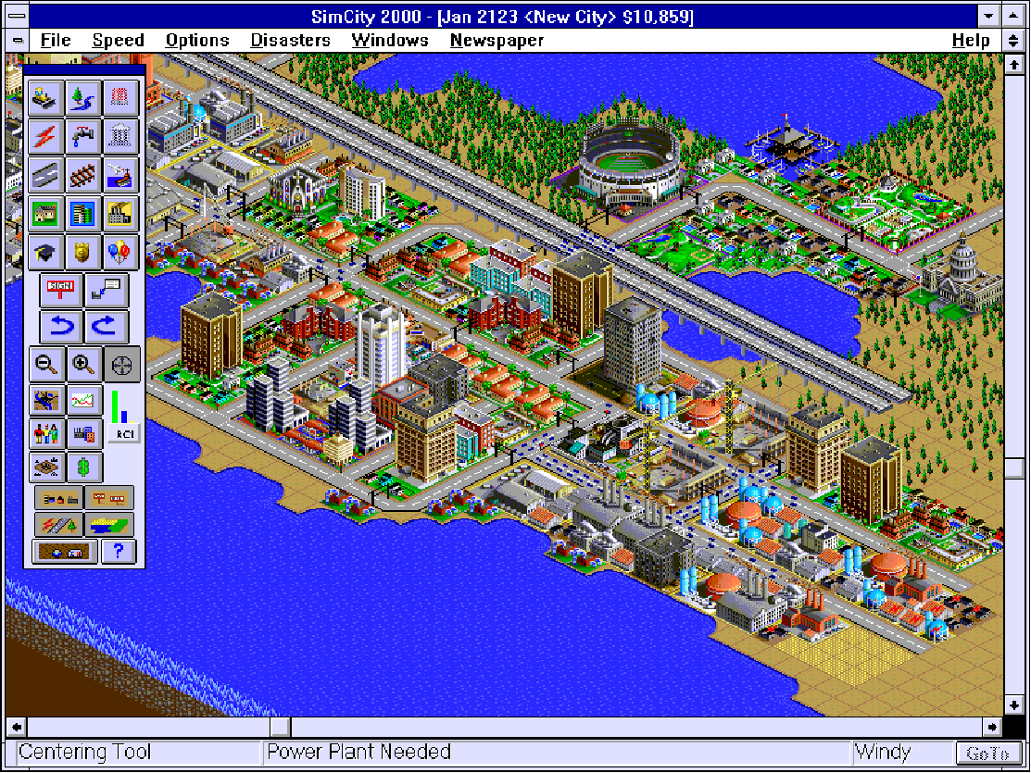
Games that model real-world systems
Sim City is a fun simulation game designed to entertain a mass audience.
Players realized its educational value, and educators have built projects and curricula around it.

Slide 25

Games that model real-world systems
present players with multiple goals, tradeoffs, and uncertainty
teach the workings of the system through play
Notes:
Games can simplify complex systems with a clear rule set.

Slide 26
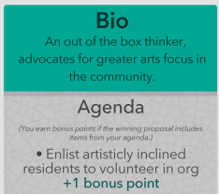
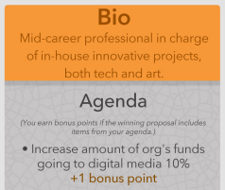
Let’s explore @Stake, a game that teaches the players to value diversity, cooperation, and negotiation.
Similar to games that model systems, games that teach values provide plenty of room to play.

Slide 27

What is @Stake?
@Stake is a paper-based game designed to spark civic process around local problems or challenges.
It is a role-playing game where players propose solutions to local challenges from the perspective of different stakeholders.

Slide 28
Challenge #3: @Stake
Goal:
Prioritize your challenges
Time:
15 min
In your groups, review the challenges you chose earlier today.
Pitch these challenges to the other groups.
Together, all the groups vote to choose the top four challenges that everyone will address, and which challenge will be addressed in each round of the game.
Notes:
Facilitator write the challenges each group shares on the board, to facilitate the voting process.

Slide 29
Challenge #3: @Stake
Goal:
To play 4 rounds of @Stake
Time:
60 min
Details
Timing
Brainstorm: 1 minute
Pitch: 1 minute/player
Deliberation: 90 seconds total
Notes:
After explaining the timing, hand out the score sheets.

Slide 30
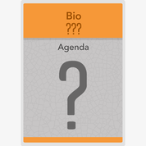
Challenge #3: @Stake
OPPORTUNITY:
Create new roles as you play!
Notes:
There is no time budgeted for players to create roles customized to their own school community, but the experience of playing the game is typically enough to get players thinking about this.

Slide 31
Challenge #3: @Stake
Goal:
To share and reflect [small and large group(s)]
Time:
10 min
What kind of impact do you envision this game having?
On students’ learning of core content?
On relationships and culture at the classroom level, school level, and within the greater school community?
Notes:
Whole class discussion, led by facilitator.
If you enjoyed this, check out alpha.projectmash.org, and look for the activites, “@Stake: Play” and “@Stake: Set Your Stakes”

Slide 32
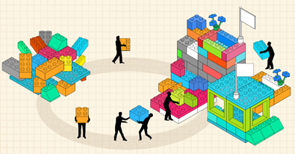
Can a game go beyond learning to facilitate real-world action?

Slide 33
Here is a good spot
for a break if you need it.

Slide 34
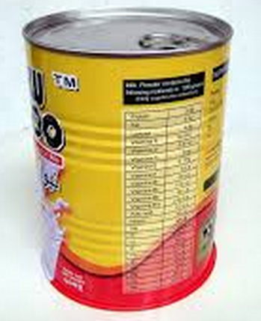
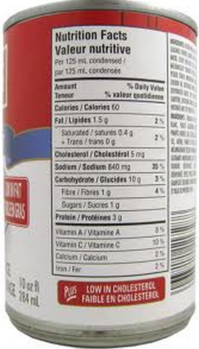
Can War Game
Students are split into teams.
Each team is assigned a fixed food budget.
Teams get points for bringing in the most nutritious canned food within their budget.
vs.

Slide 35
Can War Game
Real-world actions: Can drive
Core learning activities: Analyze nutritional info, budget for cost versus health
Values: charity, nutrition, frugality
vs.

Slide 36
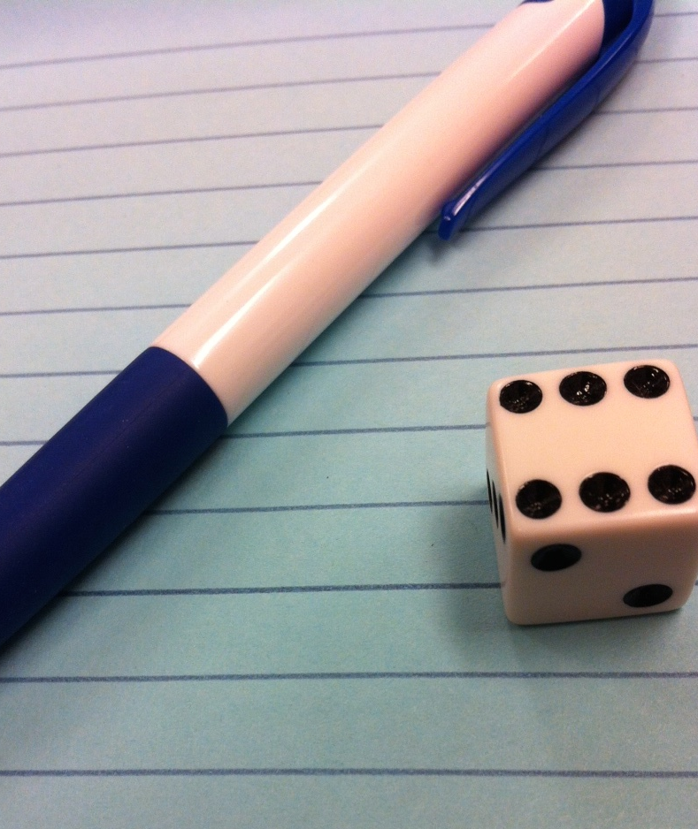
How Well Can You Spell?
Students are split into pairs.
Each pair rolls the die. The number rolled determines the number of letters in the word that the pair has to spell. (With older students, use more dice for longer words.)
Partner A writes a letter, then partner B writes a letter. This continues until a word of the specified length is spelled. (No other type of communication is allowed!)
Different pairs compete at the same time to see which pair is fastest. The first pair to win five rounds is the winner.

Slide 37
How Well Can You Spell?
Real-world actions: Being silent, spelling a word together
Core learning activities: Spelling, real-time problem-solving
Values: Collaboration

Slide 38
Challenge #4: Make your own!
Goal:
To create a game that incorporates real-world actions
In your groups:
Choose one of the four challenges from the @Stake activity. (5 min)
Create a new game that incorporates real-world actions to address your chosen challenge. (40 min)
Pitch your game to the other groups. (15 min)

Slide 39
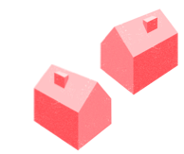
Challenge #4: Make your own!
Goal:
To create a game that incorporates real-world actions
Time:
40 min
10 minutes to define:
Real-world actions connected to your chosen challenge
Core learning activities
Values
30 minutes to define:
Name
Objective and feedback
Game actions/mechanics
Rules/boundaries

Slide 40
A Note on Process
Collaboration is more fun – and productive – when you say “yes” to your peers’ ideas. So for this challenge, try following this rule:
You get three “No, but” cards to use when saying something along the lines of, “No, we shouldn’t do that, but we should do this.” Once you’ve used each one, you can only say, “Yes!”
So, your response to every other suggestion needs to take the form of “Yes, and…” to build on teammates’ ideas.
Notes:
This strategy isn’t required, but it’s helpful.

Slide 41
Challenge #4: Make your own!
Goal:
Pitch your game
Time:
15 min
Each group pitches their game to the other groups:
Real-world actions
Core learning activities
Values
Name
Objective and feedback
Game actions/mechanics
Rules/boundaries
Notes:
Groups split into the break rooms
Then after the pitches, all groups reconvene in the main room

Slide 42
Challenge #4: Make Your Own!
Goal:
Play another group’s game
Time:
15 min
Each group plays the game created by another group. (If there is an even number of groups, pair up. Otherwise, rotate.)

Slide 43
Challenge #4: Make Your Own!
Goal:
Share, Reflect, Discuss
Time:
10 min
Consider your group’s design and the other group’s design:
What elements of each worked for you?
What would you like to change?
Notes:
Whole group discussion, led by facilitator.
If you enjoyed this, check out alpha.projectmash.org, and look for the project, “Play to Engage”

Slide 44
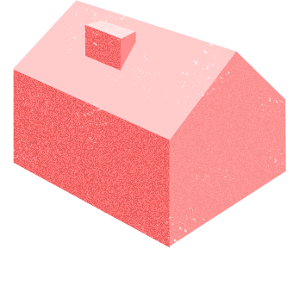
Engagement Games
/enˈgājmənt gām/
Noun
The game is the process
Acts of play are the real-world actions

Slide 45
Engagement games ground academic learning in a playful approach to real-world problems.
Engagement games are not built around a single piece of grade level content; instead, they complement, enrich, and motivate inquiry into a range of issues.
Notes:
Can Wars, How Well Can You Spell, and the games you just created are all examples of engagement games.

Slide 46
Working with your team, discuss how
engagement games:
Build skills
Foster engagement
subject matter, 21st century,
social & emotional learning
Relate to different content areas
Align with the
Common Core

Slide 47
TIME & SCHEDULE
How does the organization of time (bell schedule) play a role in planning? In what ways will your pacing have to be adjusted to integrate engagement game activities and projects into your instruction?
CLASSROOM CULTURE
How can you set up your classroom for the successful implementation of engagement game activities or projects? Is anything missing?
ASSESSMENT
What is your current system of grading and assessment? How will you apply these to engagement game activities or projects? In what ways will you have to adjust this system?
STUDENT INTEREST
How do you integrate student interest into your instruction? In what ways do engagement games support this process?
Notes:
Whole group discussion about the challenges of implementing engagement games as an approach to learning at your school.

Slide 48

projectmash.org
Notes:
Engagement Games and other approach to learning are featured on Project MASH, an online platform for teachers and students. It’s dedicated to being a source of learning experiences that involve real world problems and ways to solve them.
Project MASH is an initiative of the Pearson Foundation and the New Learning Institute. MASH has funded a range of community partners, including the Engagement Lab, to share their unique approaches to learning with a broader audience of teachers and students.

Slide 49
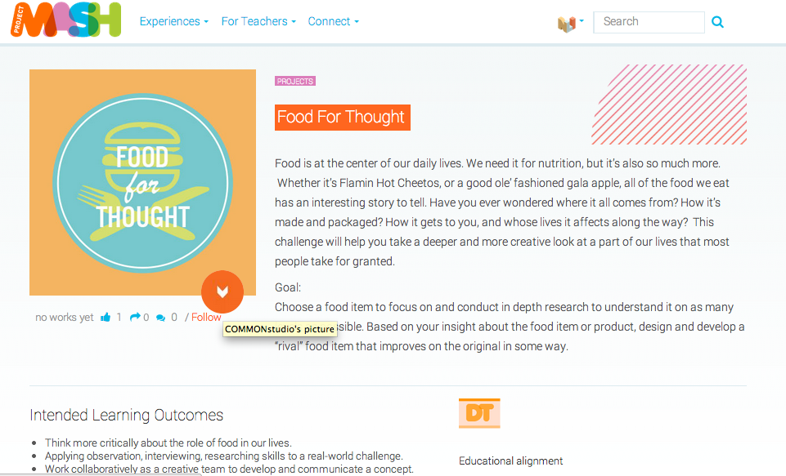
Projects &
Activities
Notes:
Project MASH includes projects and activities that are classroom-ready and that connect with the Common Core.

Slide 50
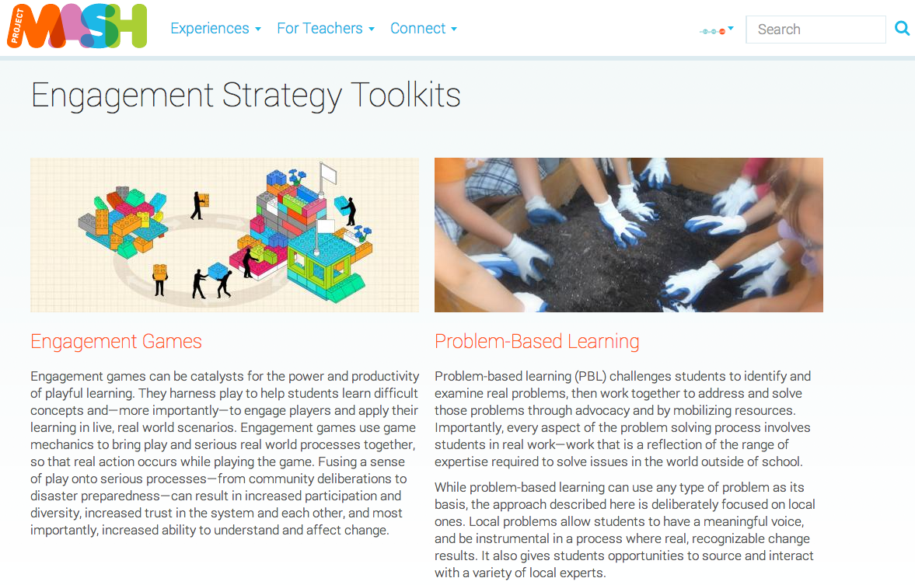
Engagement
Strategy
Toolkits
Notes:
Project MASH also houses engagement strategy toolkits that include a description of the approach, planning & assessment tools, and PPT decks that you can download to share the approach with others.

Slide 51

1. Login to Project MASH
2. Join the Engagement Games Group
3. And answer this question:
After today’s workshop, what more would you like to learn about engagement games?

